Slide 1

Digitalising Fashion Retailing Pattern Recognition PM: Final Presentation
Group11
Chen Mingyi Edmund
Chandrashekar Viswanathan
Cheng Yunfeng

Slide 2
Result Summary
01
Recap on project background, Results, Demo

Slide 3
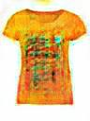
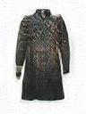
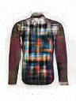
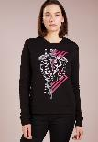
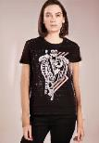
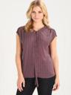
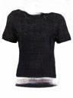
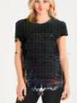
Result Summary
Objective. To create tools that aid in designs, advertising, and improving consumer experience in the fashion e-commerce industry
Generating clothing articles for design inspirations
Changing model clothing style for product marketing
Virtual Try-on to boost consumer’s online buying experience
Modelled and trained 3 GAN models
Women’s Tops
Women’s Dress
Men’s Top
Modelled and trained Cycle GAN Models
Longsleeve → shirt generator
Shirt → longsleeve generator
Modelled and trained Conditional Analogy GAN
Fashion article try-on generator

Slide 4
Webapp Demo
01
Recap on project background, Results, Demo

Slide 5


Slide 6
Generating clothing articles for design inspirations
Track 1

Slide 7
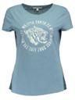
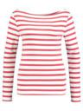
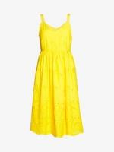
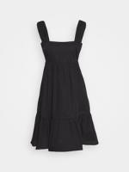
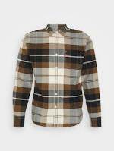
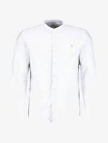
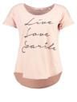
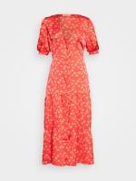
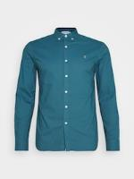
Scope
Generation of 3 styles of fashion articles
Women’s Tops
Women’s Dress
Men’s Tops

Slide 8
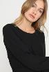

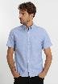
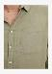
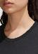


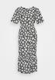
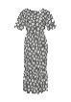
Dataset Cleaning
Datasets obtained from (i) data of open-source projects, (ii) scrapped off e-commerce sites, e.g. https://www.zalando.co.uk/
Dataset Cleaning:
Defects | Methods to Resolve | Examples
Images of human models with apparels | A pretrained face detection model was used to sieved out such images. Photos showing partial facial features had to be manually removal
Zoomed-in images on fashion apparels | Manually identified and removed
Grey/ off-white background on images | OpenCV Grabcut was used for foreground extraction. When unsuccessful, photo editing tools were used to ensure a clean white background

Slide 9
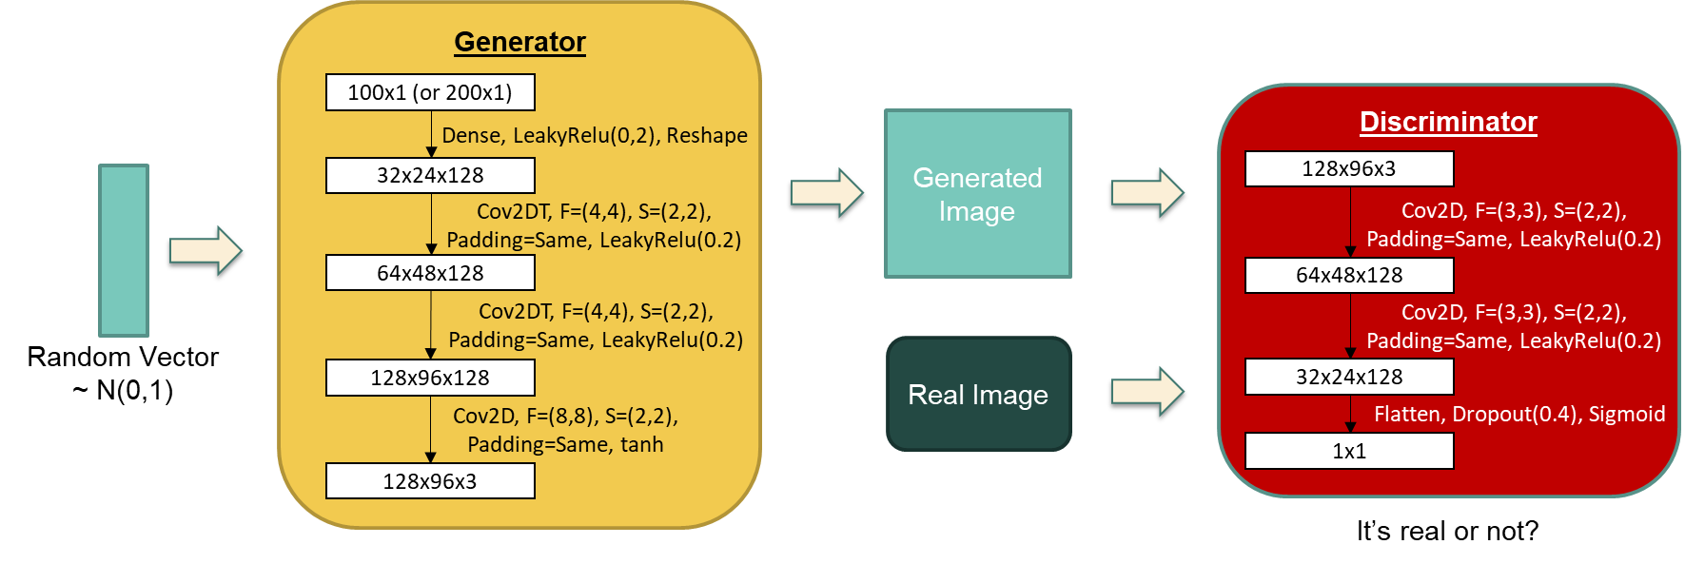
GAN Model
Training the generator
Discriminator made untrainable
Minibatch of random noise (labelled as true)
Training the discriminator
Half-minibatch of generated img (labelled as false)
Half-minibatch of real img (labelled as true)
Adam optimizer, Lr = 0.0002
Binary cross-entropy loss for discriminator

Slide 10
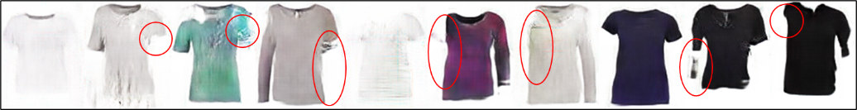
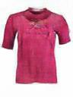
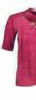
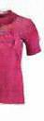
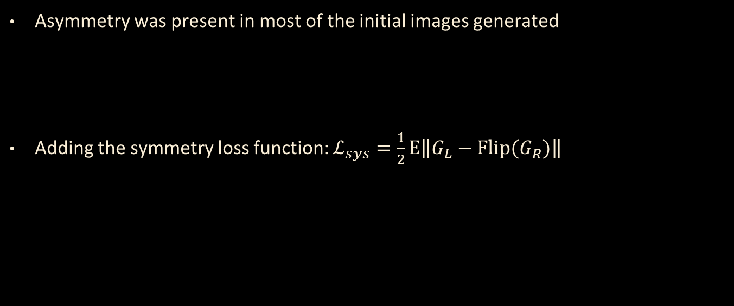
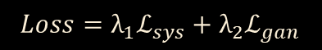
Customising GAN Loss
Asymmetry was present in most of the initial images generated
Adding the symmetry loss function: $ℒ_{sys}=\frac{1}{2}Ε\left\|\left.G_{L}−\text{Flip}(G_{R})\right\|\right.$
G_{L}
G_{R}
G_{L}
Flip(G_{R})
$${{Loss=λ}_{1}ℒ}_{sys}+{λ_{2}ℒ}_{gan}$$
−
λ₁ = 0.1 and λ₂ = 0.9

Slide 11
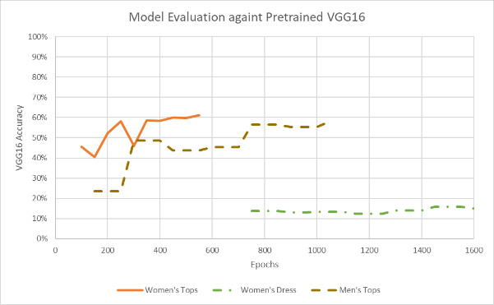
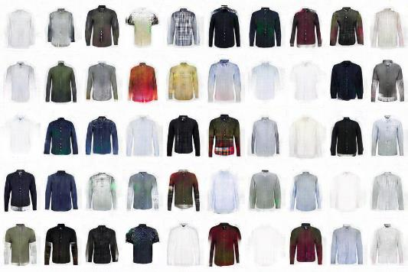
Performance Measures
Comparing against VGG16 pretrained on ImageNet
Classes associated to apparels identified
If a generated image was classified into one of these classes, it is deemed successful
Manual inspection. 50 images generated for each style and screened manually for
Mis-shaped clothing,
Diversity in design, and
General correctness of the generated img
Women’s Tops: 61%
Men’s Tops: 58%
Women’s Dress: 16%

Slide 12
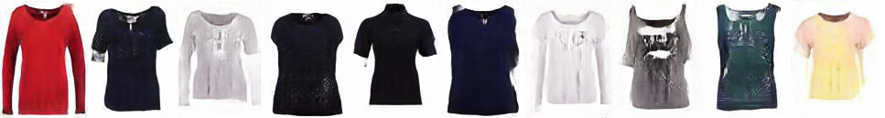
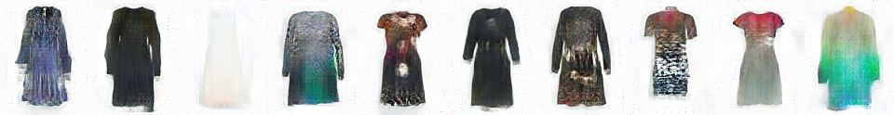
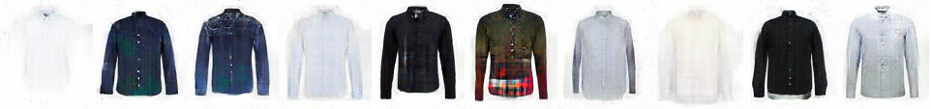
Sample Results

Slide 13

Virtual Try-on to boost consumer’s online buying experience
Track 2

Slide 14
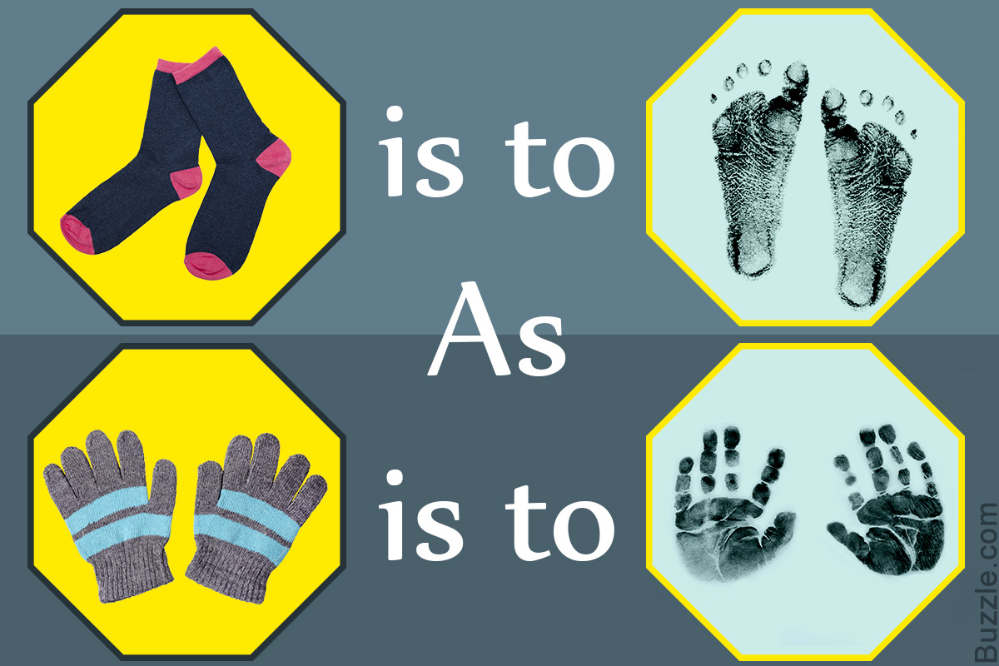
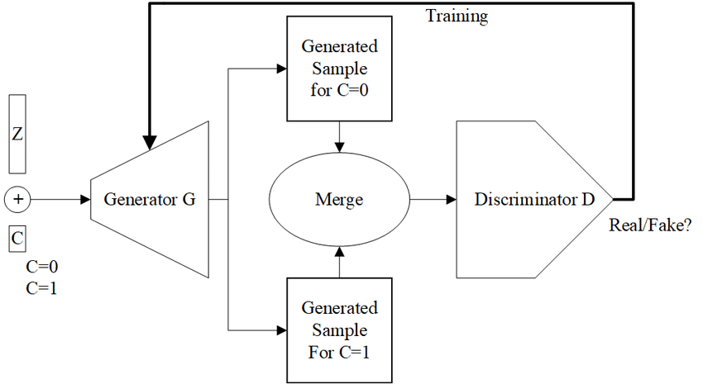
Conditional Analogy GAN
A special type of GAN which uses conditioning information to solve image
analogy problem

Slide 15
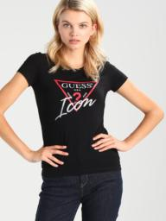
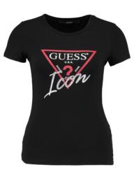
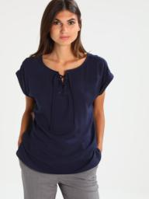
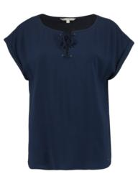
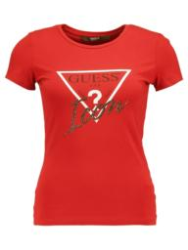
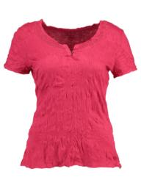
Dataset
Scope for Virtual Try On is limited to only women’s tops.
Online open-source dataset (~14k image pairs)

Slide 16
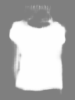
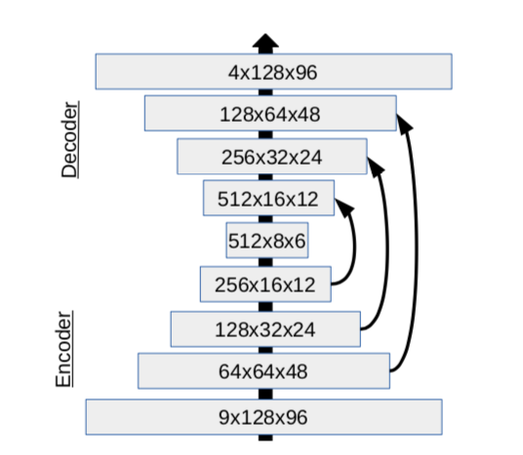
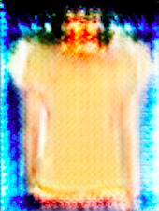
CAGAN Model - Generator
Segmentation
mask
RGB Colour
image
Generator

Slide 17
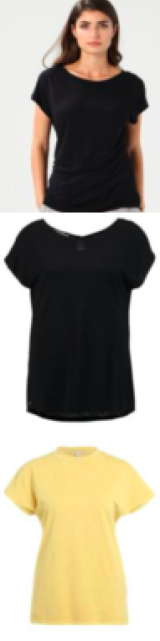
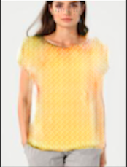
CAGAN Model - Generator
Generator

Slide 18
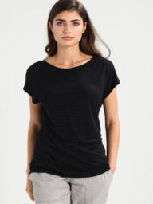
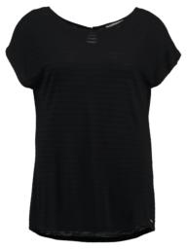


CAGAN Model - Discriminator
Positive
Real
Negative
Negative
Fake
Discriminator

Slide 19


Loss function
Overall Loss function
Minimax Loss function

Slide 20








Results

Slide 21
Style Swapping for product marketing
Track 3

Slide 22
CycleGAN
as close as possible
Domain X
G: X -> Y
Domain Y
F: Y -> X
Domain X
Discriminator Y
Discriminator X
Dataset
(Domain Y)
Dataset
(Domain X)

Slide 23
















Dataset
Extracted from Zalando
Long Sleeve | Shirt

Slide 24
Objective Function

Slide 25


CycleGAN Model
Generator
Discriminator

Slide 26


Sample Results
Long Shirt
Shirt Long

Slide 27
Thank You

